Slide 1
Advances in Data Sciences Mid Term Project Prudential Life Insurance Assessment
Group 7
Priyank Agrawal
Purnima Naik
Wanwan Zhang
Professor: Dr. Subrata Das

Slide 2
Data Pre-processing and Cleaning
The Prudential life insurance dataset has 127 independent variables and 1 dependent variables with over 58000 records. These 128 features are either continuous, discrete or categorical in nature.
Some of the continuous columns like Employment_Info_1, Employment_Info_4, Family_Hist_2 and discrete columns like Medical_History_1, Medical_History_15 had missing/NA values. Such values were replaced by the mean of values of the respective column they were present in. Mean was used instead of max, min or frequent value for this purpose so that the distribution of the values is not disturbed.
Some of the discrete columns like Medical_History_10, Medical_History_24 had over 90% missing values so such columns were eliminated from the study.
Categorical columns like Product_Info_3, Medical_History_2, Employment_Info_2 had more than six categories which led to their elimination from the dataset.
Product_Info_2 having values like A1,B1 was split into two separate columns having Product_Info_2_Char and Product_Info_2_Number which contained the records corresponding character (ex. A) and number (ex. 1).
Categorical columns with two values (ex. 1, 2) were converted to Binary (0, 1) and those having more than 2 values were split into different columns using 1 to N transformation.
Discrete columns like Medical_History_1_D and Medical_History_15_D having minimum value 0 and maximum value 240 were normalized between 0 to 1 using normalization formula.
Notes:
How presentation will benefit audience: Adult learners are more interested in a subject if they know how or why it is important to them.
Presenter’s level of expertise in the subject: Briefly state your credentials in this area, or explain why participants should listen to you.

Slide 3
Multiple Linear Regression: Introduction & Steps
The multiple linear regression is used to explain the relationship between one continuous dependent variable from two or more independent variables.
Steps involved during building the multiple linear regression model for the prudential life insurance dataset were:
Splitting the dataset into test dataset and train dataset.
Generating the first linear regression model with all the 127 independent variables and checking R-squared and adjusted R-squared values.
After building the model many variables had singularity (similarity) with other variables leading to their elimination.
Again the model was build this time with fewer number of columns and R-squared, adjusted R-squared were checked.
This time the variables (columns) having less or no significance in the model on observing their significant codes were eliminated.
The final linear regression model was selected after the R-squared and adjusted R-squared values started to decrease after eliminating more columns that were later restored.
The final model was used to predict the Response variable for the test dataset predicting values anywhere between 1 to 8.
The predicted output and the actual output was then used to get the mean squared error by applying MSE formula.
Notes:
Lesson descriptions should be brief.

Slide 4
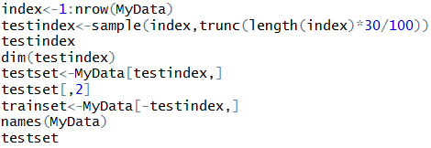
Multiple Linear Regression: Code & Summary
Code Snippet
Summary
Data split:
First Model:
First model summary:
Residual standard error: 1.959 on 41519 degrees of freedom
Multiple R-squared: 0.3645
Adjusted R-squared: 0.3638
F-statistic: 506.6 on 47 and 41519 DF
p-value: < 2.2e-16
Notes:
Example objectives
At the end of this lesson, you will be able to:
Save files to the team Web server.
Move files to different locations on the team Web server.
Share files on the team Web server.

Slide 5
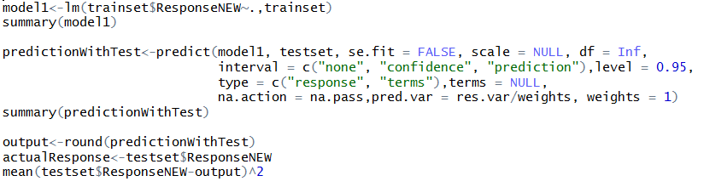
Multiple Linear Regression: Code & Summary
Code Snippet

Slide 6
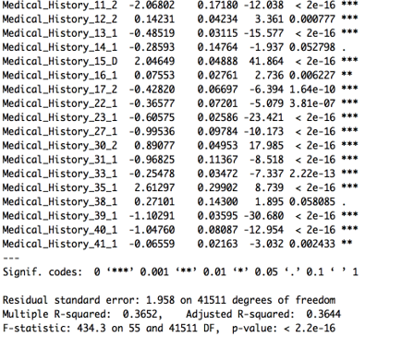
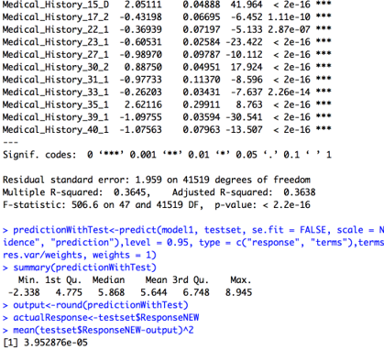
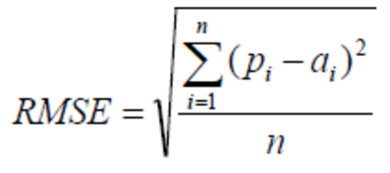
Multiple Linear Regression: Wrap-up
First Model
Final Model
RMSE = 1.988140

Slide 7
SVM Regression: Introduction & Steps
Support Vector Machines are very specific class of algorithms, characterized by usage of kernels, absence of local minima, sparseness of the solution and capacity control obtained by acting on the margin, or on number of support vectors, etc.
Steps involved during building the support vector machines model for the prudential life insurance dataset were:
Removing the redundant data on the basis of multiple linear regression model study.
Dimension Reduction using Random Forest.
Build the SVM Regression Model
Build and Evaluate.

Slide 8
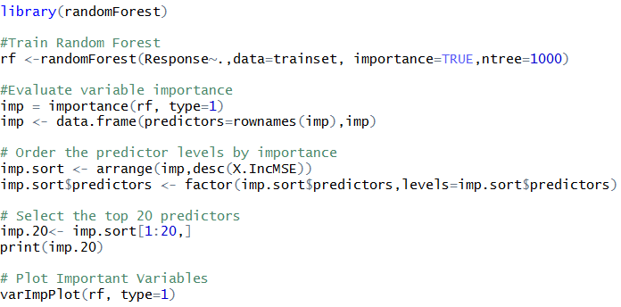
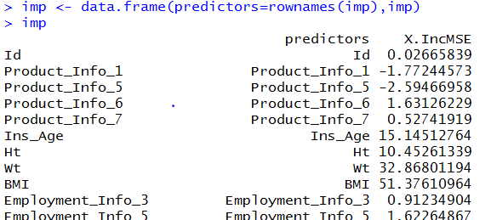
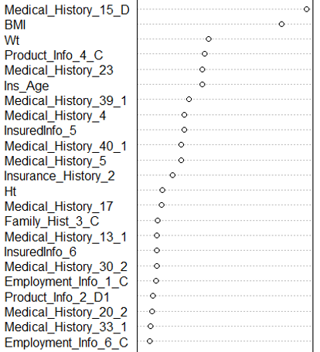
SVM: Dimension Reduction
Code Snippet
Plot

Slide 9
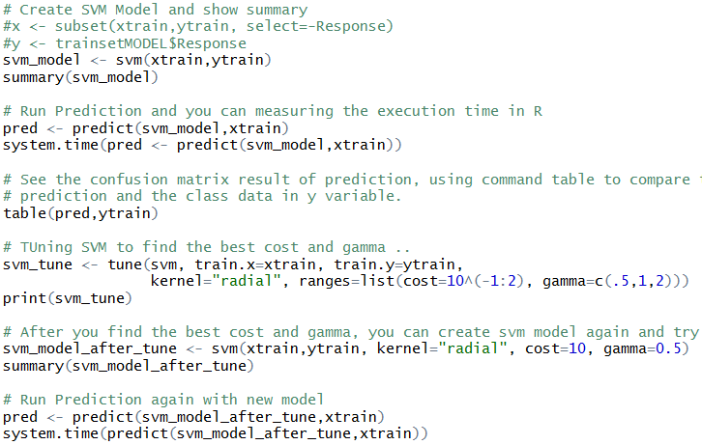
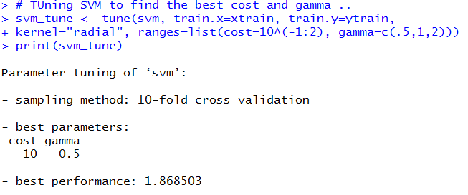

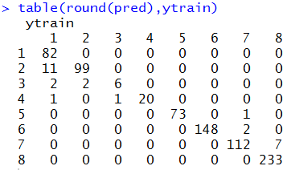
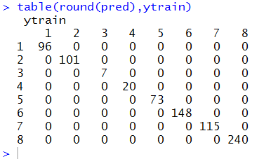
SVM: Code & Summary
Code Snippet
Summary

Slide 10
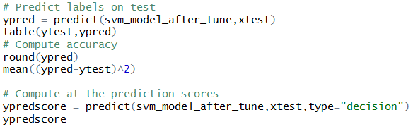

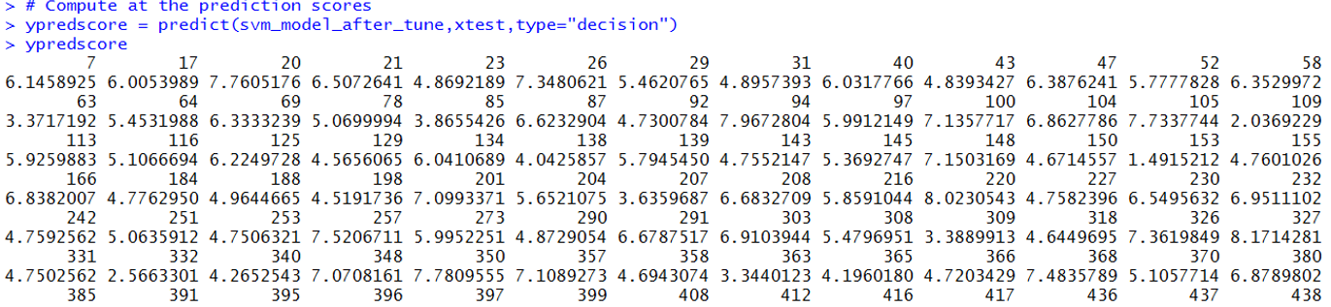
SVM: Wrap-up
Prediction Code Snippet
Result

Slide 11
Decision Tree Regression: Introduction & Steps
Decision tree builds regression or classification models in the form of a tree structure. It brakes down a dataset into smaller and smaller subsets while at the same time an associated decision tree is incrementally developed.
The final result is a tree with decision nodes and leaf nodes. The topmost decision node in a tree which corresponds to the best predictor is called root node.
Steps involved during building the multiple linear regression model for the prudential life insurance dataset were:
Collect, explore and prepare the data.
Train a model on the data
Visualizing the decision trees
Evaluating model performance
Measuring performance with the mean absolute error
Improving model performance

Slide 12

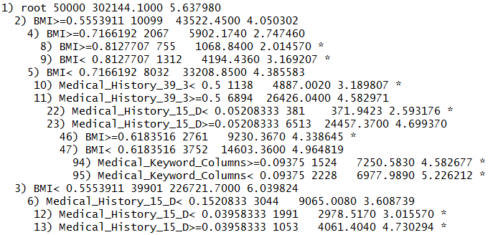
Decision Tree Regression: Training/Exploring Model
Splitting the data:
Training the model:
Exploring the model:

Slide 13
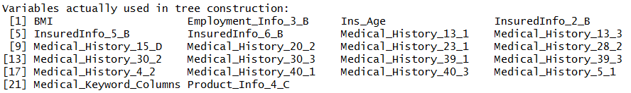
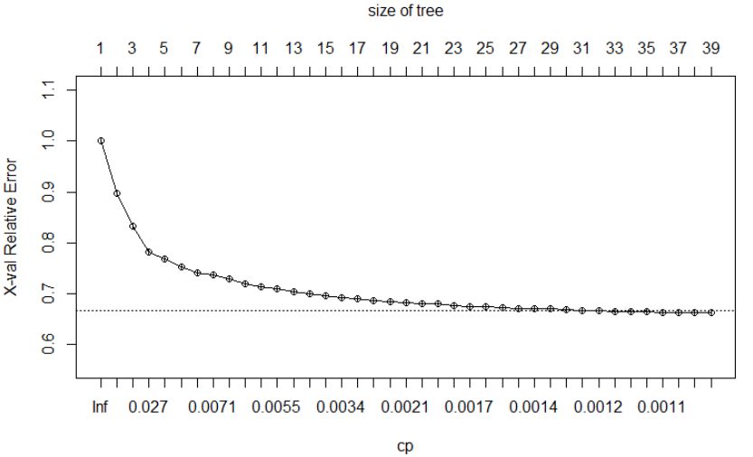
Decision Tree Regression: Variable Importance
Variable Importance:
Complexity Parameter error

Slide 14
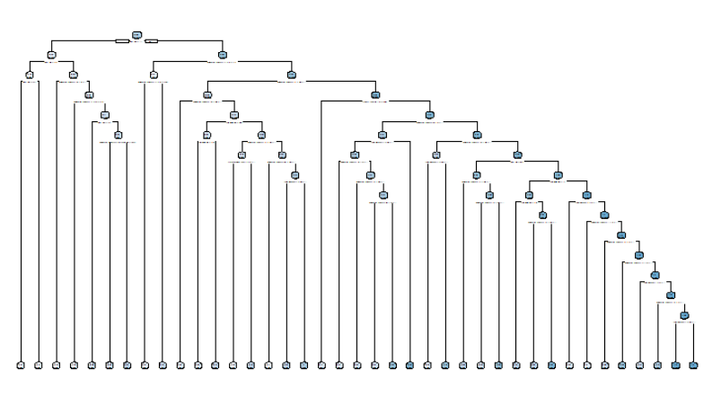
Decision Tree Regression: Visualizing the tree

Slide 15

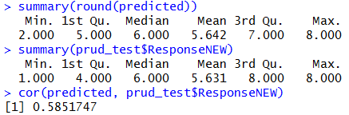


Decision Tree Regression: Evaluating & Improving Performance & MAE
Code Snippet
Summary

Slide 16
Thank You

